Slide 1
R/place Bot Detection V2
By Sam Kaseff and
Sean Patrick King.

Slide 2
Method
We used Amazon S3 buckets and Jupyter within AWS Sagemaker to analyze the data from R/place data to try to recognise any bots.

Slide 3
Our New Method
Data Upload | Uploaded the dataset used for our previous analysis into an S3 bucket.
Jupyter Sagemaker | Loaded the data from the S3 bucket into a Jupyter notebook within Sagemaker.
Bot Detection | To find bots we looked at areas where people were placing the most pixels.
Bot Detection | We also looked at areas with high instances of repeat users.
Artwork Involved with Bots | Examine which artwork was created or covered up by bots.

Slide 4
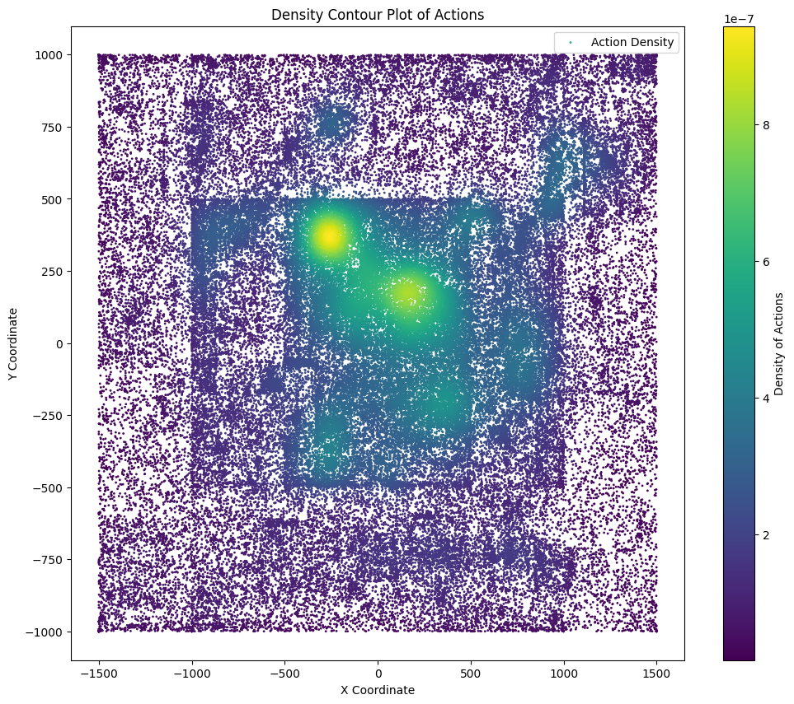
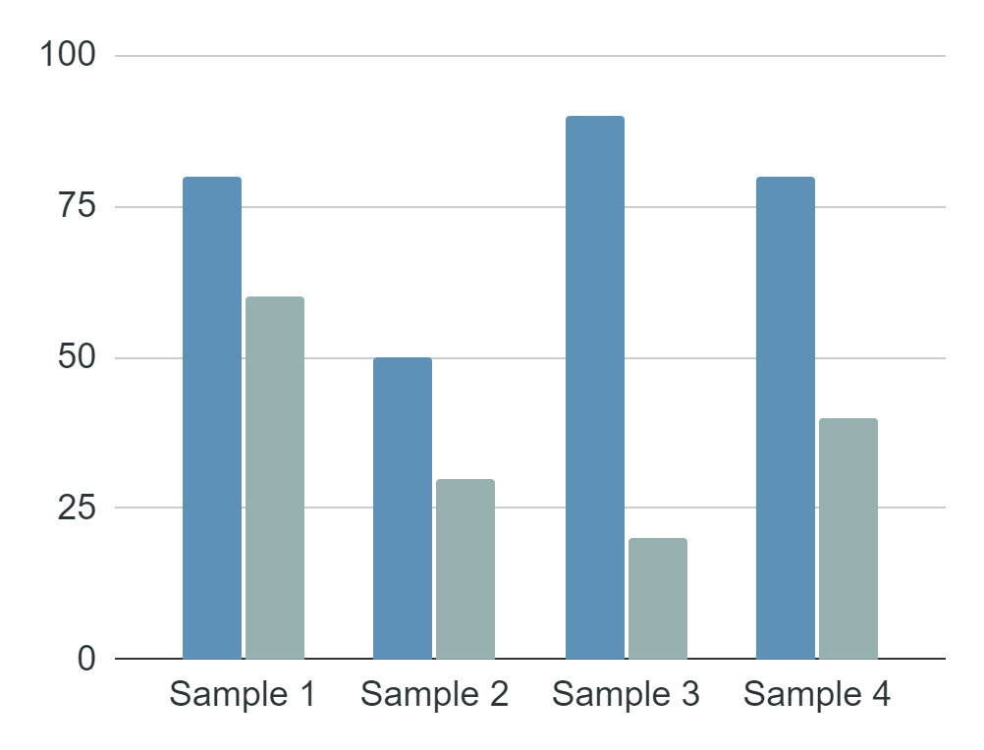
Bot Detection.
Density Contour Plot
Provides a clear view of where user activity is most concentrated in r/place. This information overlaid over the pixels gives you a good idea of where there is potential bot activity.

Slide 5
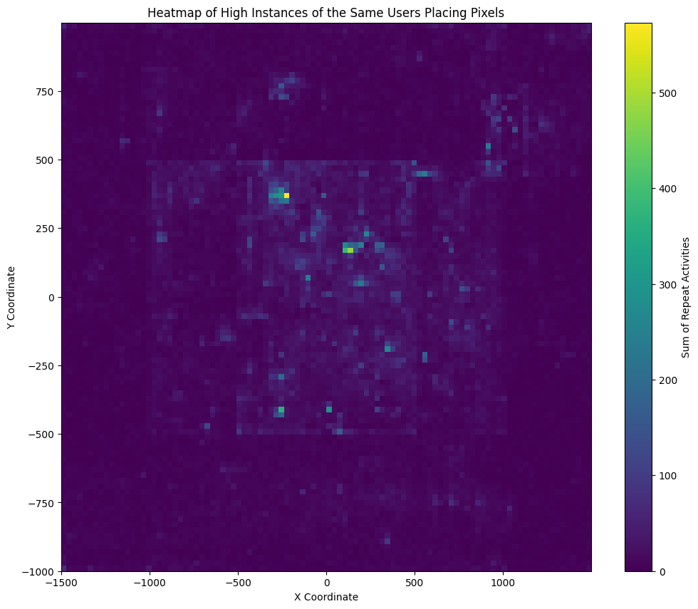
Bot Detection.
Heat map
This heat map shows where the most repeat users are placing pixels in r/place. It lines up nicely with the areas that have the most user activity from the density contour plot.

Slide 6
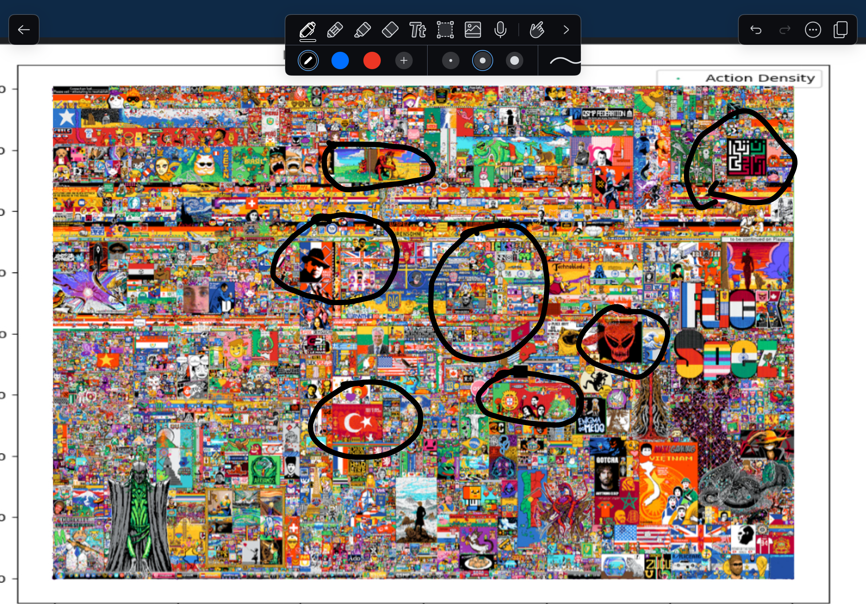
Heavily Affected Artwork

Slide 7
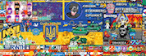

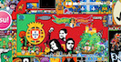
Heavily Affected Artwork
Iranian Women’s Resistance
Flag of Ukraine
Flag of Portugal
To protest upcoming Reddit API restrictions, r/portugal initially did not participate. However, after some Portuguese streamers got involved, infighting occurred, leading to a strange coverup by Portuguese bots.
The Flag of Ukraine located near the center was potentially covered up by Russian bots to diminish the war effort.
This symbol in the upper right was for the resistance movement brought against the Iranian government for the freedom of women in Iran. This artwork was also potentially covered up by Iranian bots for political purposes

Slide 8
Conclusions
Bots
Effects
Solution?
Bots are very present within r/place and can make a big impact on artworks.
Bots seem to target larger projects, particularly ones with nationalistic messages such as flags.
Raise the time that it takes for a user to put in a new pixel. Do not allow newly created accounts to participate.

Slide 9
Thank You!
Questions?

